Slide 1

SALES PERFORMANCE
OF ABC COMPANY

Slide 2
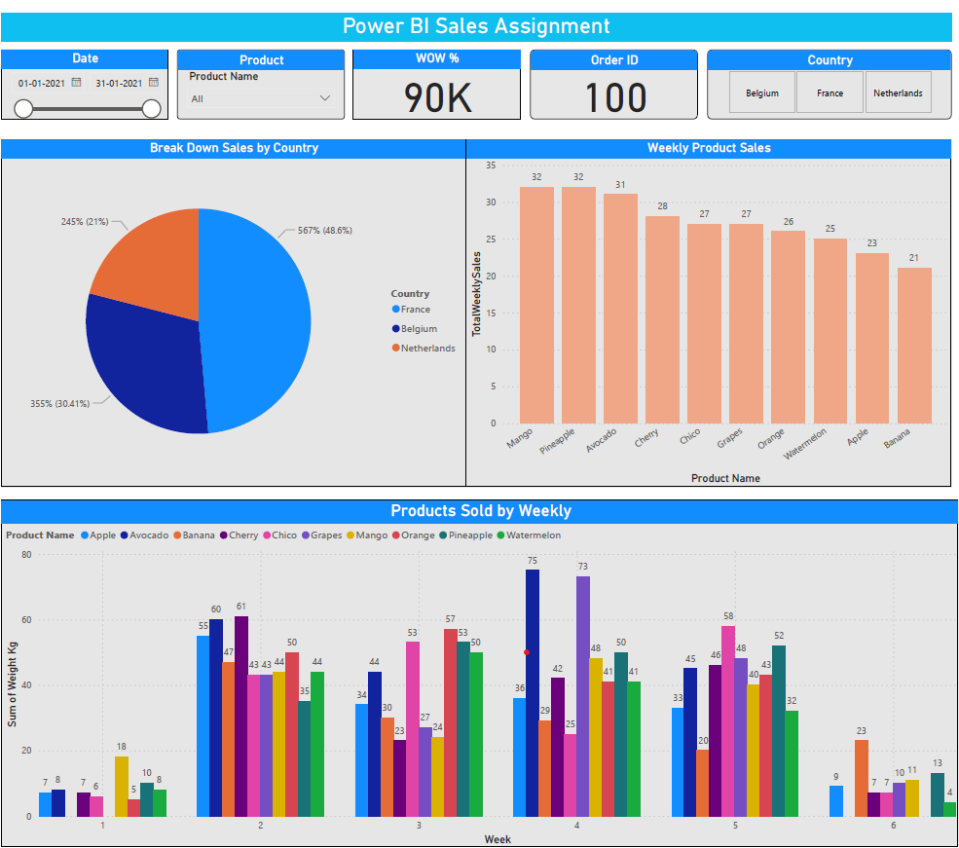
Breakdown of Sales per Country and Volume of Products Sold Weekly Visuals

Slide 3
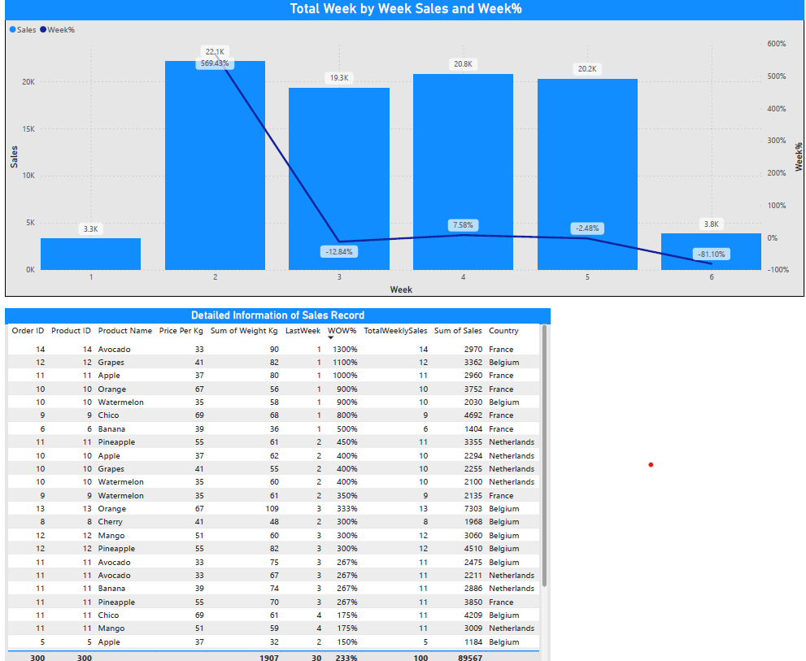
Total Weekly Sales, Including a week-over-week comparison Increasing &
Decreasing sales Detailed Information of Each Sales Record.

Slide 4
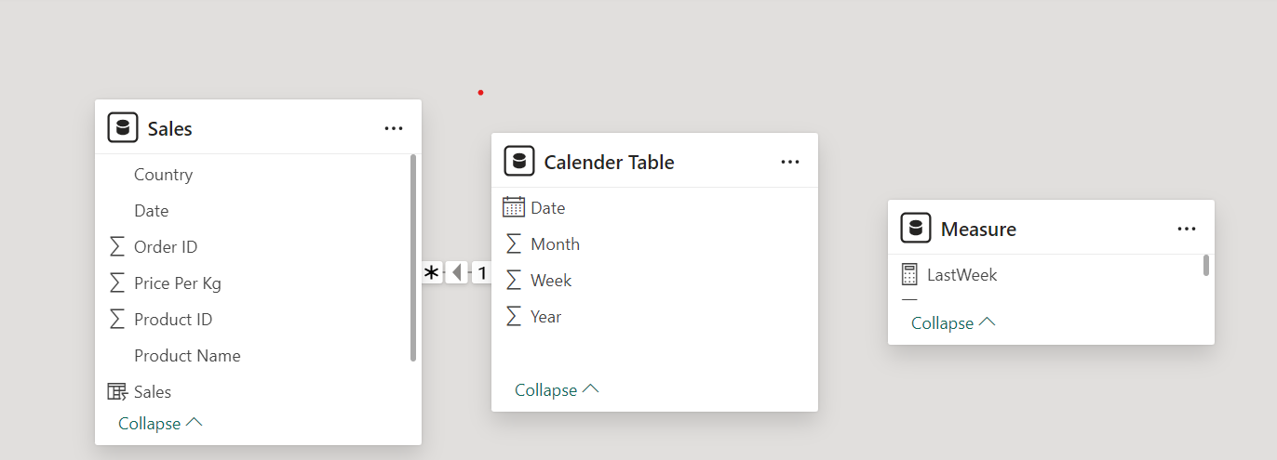
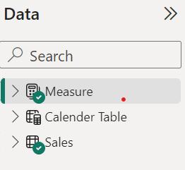
Total Weekly Sales, Including a week-over-week comparison Increasing &
Decreasing sales Detailed Information of Each Sales Record.
Data Model View Construct a Schema from the Aggregated data.

